Slide 1

UNIVERSITY COLLEGE OF ENGINEERING KANCHEEPURAM COMPUTER SCIENCE AND ENGINEERING
STOCHASTIC GRADIENT DESCENT BASED HATE SPEECH DETECTION IN SOCIAL NETWORKS
BATCH MEMBERS :
1. GOKUL S (513419104015)
2 HARIPRAKASH M (513419104017)
3. KISHORE KUMAR M (513419104023)
GUIDED BY –Mrs.T.Kala M.E(PhD)
Assistant Professor, Dept. of CSE

Slide 2
ABSTRACT
The detection of hate speech in social media is a crucial task.
The uncontrolled spread of hate has the potential to gravely damage our society, and severely harm marginalized people or groups.
As online content continues to grow, so does the spread of hate speech.
The Project identifies and examine challenges faced by online automatic approaches for hate speech detection in text.
Among these difficulties are subtleties in language, differing definitions on what constitutes hate speech, and limitations of data availability for training and testing of these systems.

Slide 3
AIM / OBJECTIVE
Hate speech is a big problem on the internet. It can be found on social media, in comment sections, and even in online forums.
Machine learning algorithms can be used to detect hate speech.
These algorithms can analyze text and identify hate speech.
They can also be used to determine the tone of a text.
This can be used to identify hate speech that is disguised as jokes or sarcasm.
Machine learning algorithm and NLP is used to detect the hate speech.

Slide 4
LITERATURE REVIEW
S.NO | TITLE | AUTHOR NAME | YEAR & PUBLICATION | DRAWBACK
1. | Cross-Lingual Few-Shot Hate Speech and Offensive Language Detection Using Meta Learning | Marzieh Mozafari; Reza Farahbakhsh; Noel Crespi | 2022 & IEEE | Experiments show that meta learning-based models outperform transfer learning-based models in most cases, and that Proto-MAML is the best performing model, as it can quickly generalize and adapt to new languages
2. | Hate Speech Detection using Machine Learning | P. Preethy Jemima; Bishop Raj Majumder; Bibek Kumar Ghosh; Farazul Hoda | 2022 & IEEE | Data from social media sites such as Twitter are used to test the effectiveness of these procedures, and they reveal a 6-percentage point improvement in macro-average F1 or a 9 percent improvement for content that has been labeled as hateful, respectively.

Slide 5
LITERATURE REVIEW (CONT..I)
S.NO | TITLE | AUTHOR NAME | YEAR & PUBICATION | DRAWBACK
3. | PDHS: Pattern-Based Deep Hate Speech Detection With Improved Tweet Representation | P. Sharmila; Kalaiarasi Sonai Muthu Anbananthen; Deisy Chelliah; Sudhaman Parthasarathy; Subarmaniam Kannan | 2022 & IEEE | The experimental results on Twitter Dataset can learn effective features to enhance the performance with minimum training time and attained 88%F1Score.
4. | Deep Learning Based Fusion Approach for Hate Speech Detection | Yanling Zhou; Yanyan Yang; Han Liu; Xiufeng Liu; Nick Savage | 2020 & IEEE | The ExperimeNt shows that the accuracy and F1-score of the classification are significantly improved.

Slide 6
PROPOSED WORK
SGD is used for hate speech classifications. SGD stands for Stochastic Gradient Descent .
Stochastic Gradient Descent (SGD) is a variant of the Gradient Descent algorithm used for optimizing machine learning models. In this variant, random training example is used to calculate the gradient and update the parameters at each iteration.
SGD is still computationally much less expensive than typical Gradient Descent. Hence, in most scenarios, SGD is preferred over Batch Gradient Descent for optimizing a learning algorithm.

Slide 7
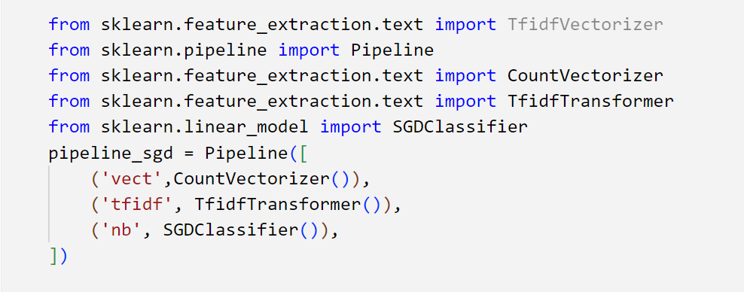
ALGORITHM
STOCHASTIC GRADIENT DESCENT

Slide 8
SYSTEM ARCHITECTURE
Pre processing
Lower case
Converting text to float
Count vector
Text input
Punctuation remover
TF-IDF
Test data
Model
SGD Algorithm
Training Data
Output

Slide 9
LIST OF MODULES
Proposed System consists of three module phases:
Phase 1
Data gathering
1.Kaggle
Data preprocessing
1.TF-IDF
2.Count Vectorization
3.Punctuation Removal

Slide 10
MODULES
Phase 2
choose a model
1.Stochastic Gradient Method
2.Long short-term memory(LSTM)
3.Convulational neural networks(CNN)
4.Bi-directional LSTM

Slide 11
MODULES
Train the model
STOCHASTIC GRADIENT DESCENT
Phase 3
Evaluate model
1.Precision
2.Recall
3.F-1 Score

Slide 12
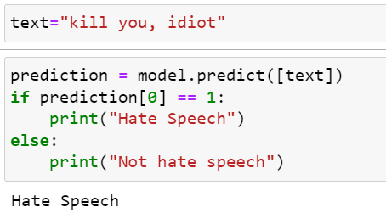
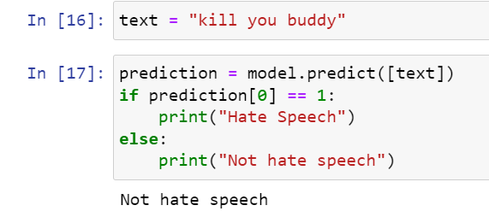
OUTPUT
Hate Speech
Not Hate Speech

Slide 13
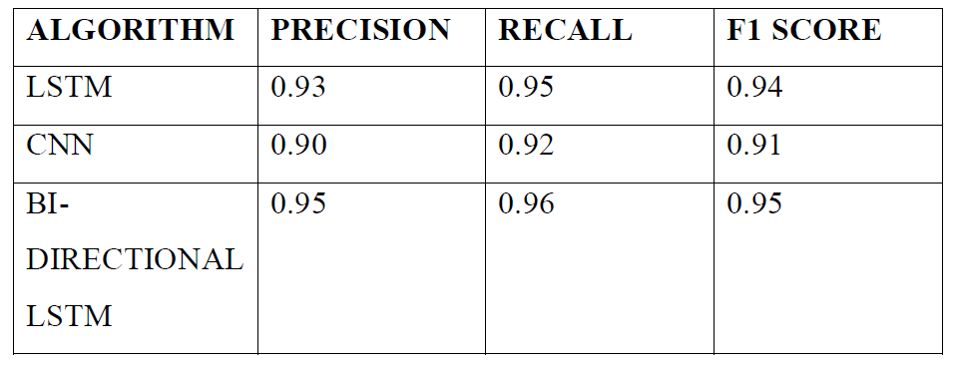
PERFORMANCE METRICS
EXISTING SYSTEM

Slide 14
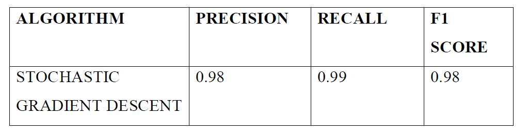
PERFORMANCE METRICS(CONT..)
PROPOSED SYSTEM

Slide 15
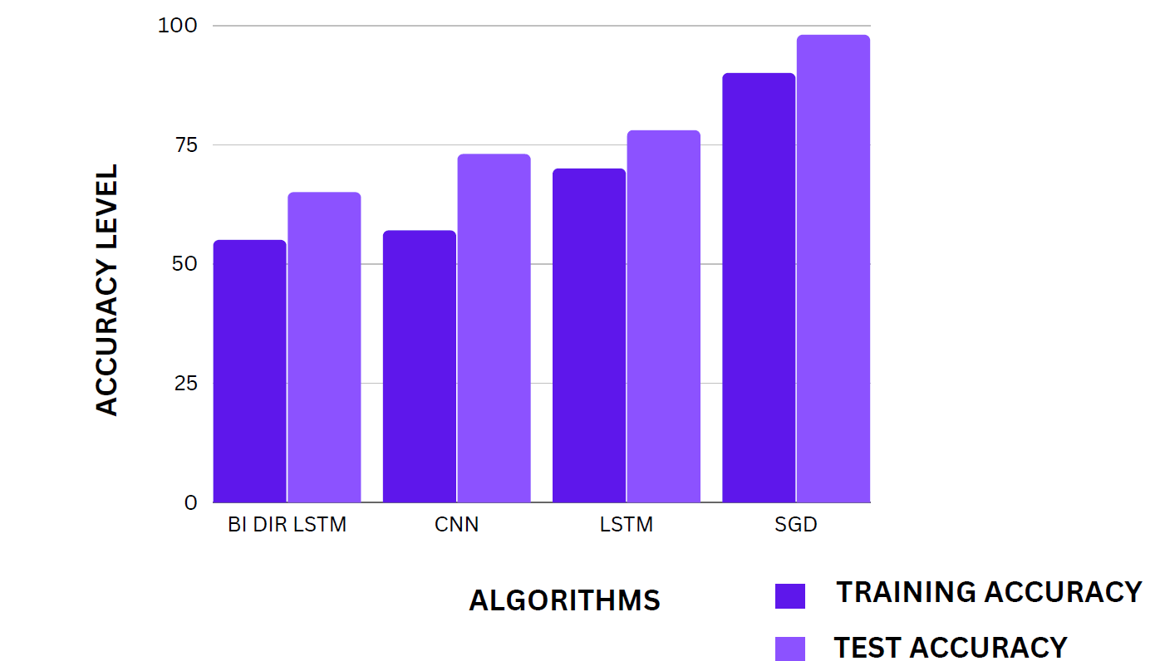
COMPARATIVE ANALYSIS

Slide 16
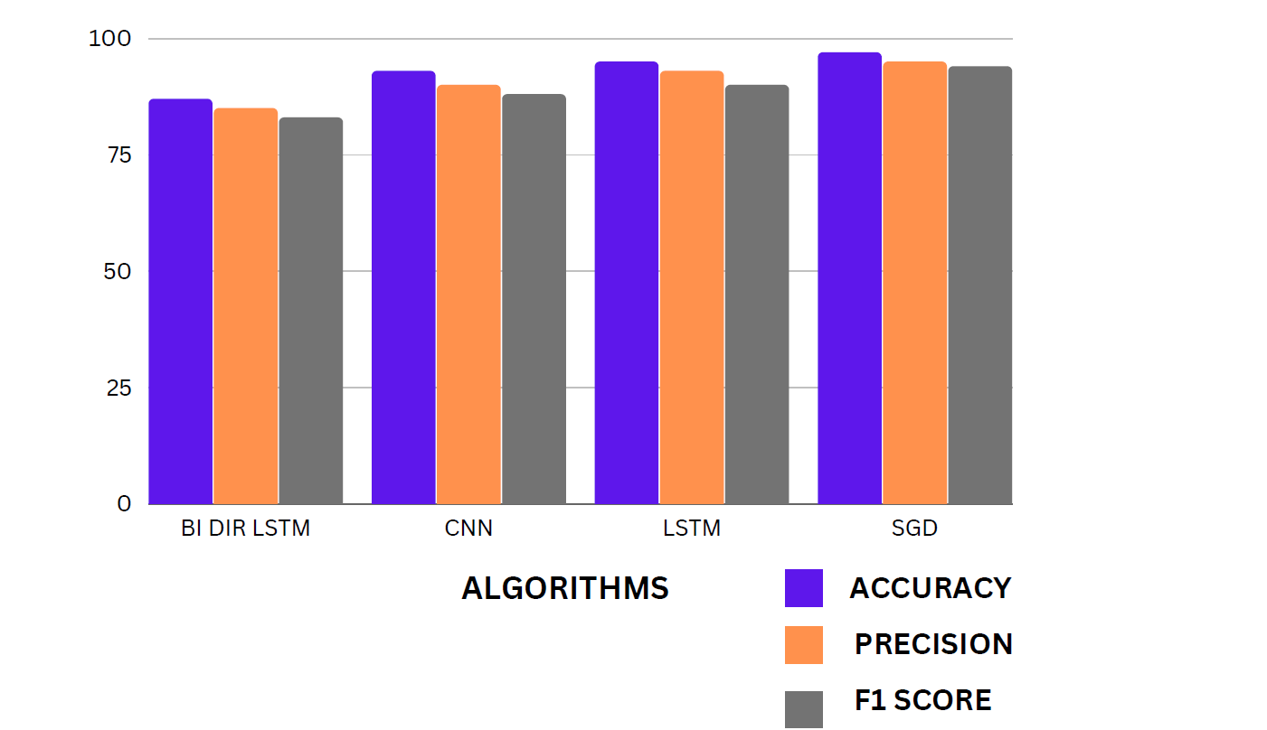
COMPARATIVE ANALYSIS(CONT.)

Slide 17
CONCLUSION
As hate speech continues to be a societal problem, the need for automatic hate speech detection systems becomes more apparent.
The current work approaches for this task as well as a new system that achieves reasonable accuracy.
It consist new approach that can out perform existing systems at this task, with the added benefit of improved interpretability.

Slide 18
FUTURE WORKS
The dataset is collected from kaggle and using those dataset, by training the models. In the proposed work accuracy of the model is increased using stochastic gradient descent. The existing system has an accuracy of 93% and the proposed system provides an accuracy of 98%.
The future work of the project is to make real time predictions of hate speech in social media. The model could be trained with more dataset and the model can have even higher accuracy.

Slide 19
REFERENCES ( CONT.. I)
P. K. Jain, V. Saravanan, and R. Pamula, ‘‘A hybrid CNN-LSTM: A deep learning approach for consumer sentiment analysis using qualitative usergenerated contents,’’ ACM Trans. Asian Low-Resource Lang. Inf. Process., vol. 20, no. 5, pp. 1–15, Sep. 2021.
A. Kamaal and M. Abulaish, ‘‘CAT-BiGRU: Convolution and attention with bi-directional gated recurrent unit for self-deprecating sarcasm detection,’’ Cognit. Comput., vol. 14, pp. 91–109, Jan. 2021.
P. K. Jain, R. Pamula, and E. A. Yekun, ‘‘A multi-label ensemble predicting model to service recommendation from social media contents,’’ J. Supercomput., vol. 66, no. 1, pp. 1–20, Sep. 2021.

Slide 20
REFERENCES(CONT.. II)
E. W. Pamungkas, V. Basile, and V. Patti, ‘‘A joint learning approach with knowledge injection for zero-shot cross-lingual hate speech detection,’’ Inf.Process. Manage., vol. 58, no. 4, pp. 1–19, 2021.
K. Miok, B. Skrlj, D. Zaharie, and M. Robnik-Sikonja, ‘‘To ban or not to ban: Bayesian attention networks for reliable hate speech detection,’’ Cognit. Comput., vol. 21, no. 1, pp. 1–19, 2021.
S. Kiritchenko, I. Nejadgholi, and K. C. Fraser, ‘‘Confronting abusive language online: A survey from the ethical and human rights perspective,’’ J. Artif. Intell. Res., vol. 71, pp. 431–478, Jul. 2021

Slide 21
THANK YOU

